Slide 1
Big Data Analysis and Mining
Junming Shao

Slide 2
Subspace Learning

Slide 3
Outline
Motivation
Application
Dimension Reduction
Feature Selection
Subspace Clustering
Conclusion

Slide 4
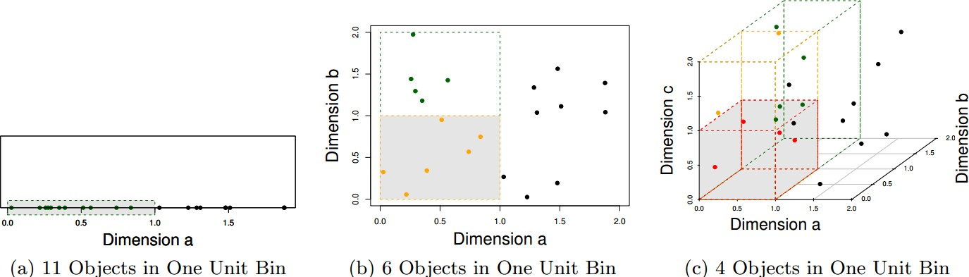
Motivation
Curse of dimensionality (Neighbors Search)
Similarity Calculation is a difficult thing for high-dimensional data

Slide 5
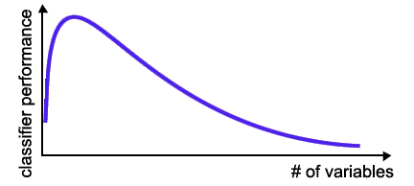
Motivation
Curse of dimensionality (Classification)
The required number of samples (to achieve the same accuracy) grows exponentially with the number of variables!
In practice: number of training examples is fixed!
=> the classifier’s performance usually will degrade for a large number of features!
5/54

Slide 6
And many more …
In general, we face a steadily increasing number of applications that require the analysis of moderate-to-high dimensional data
Moderate-to-high dimensional means from appr. 10 to hundreds or even thousands of dimensions
How to handle these high-dimensional data?

Slide 7
Part 1. Dimension Reduction

Slide 8
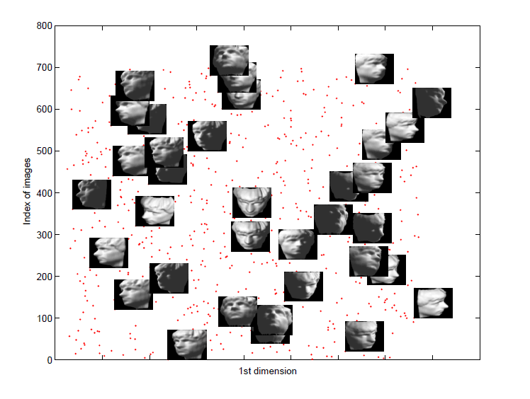
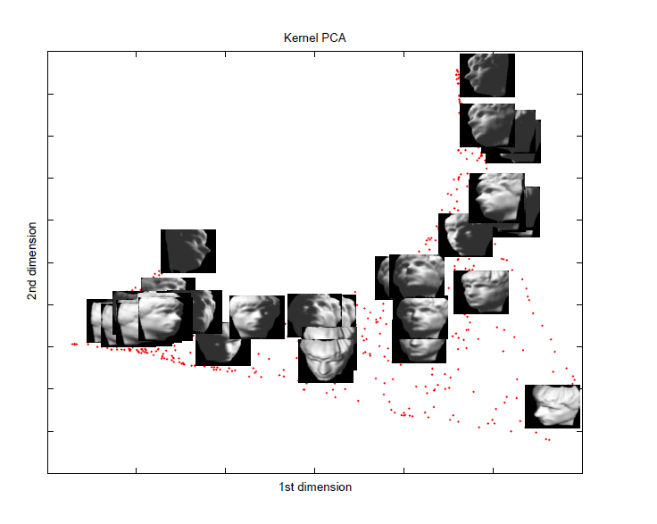
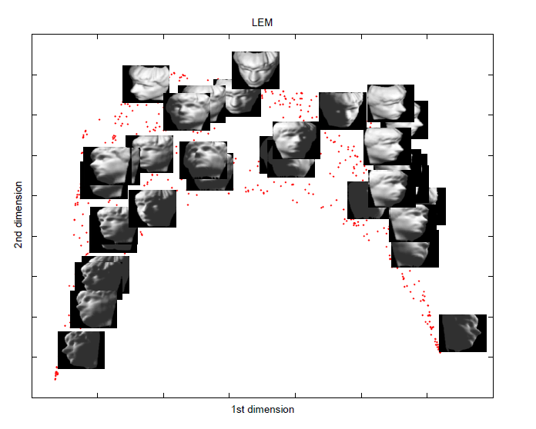
Examples
Dimension Reduction

Slide 9
Models
Dimension Reduction
Linear methods
Principal component analysis (PCA)
Multidimensional scaling (MDS)
Nonlinear methods
Locally linear embedding (LLE)
Laplacian eigenmaps (LEM)
Isomap

Slide 10
Principal Component Analysis (PCA)
Dimension Reduction
History: Karl Pearson, 1901
Find projections that capture the largest amounts of variation in data
Find the eigenvectors of the covariance matrix, and these eigenvectors define the new space
x₂
e
x₁

Slide 11
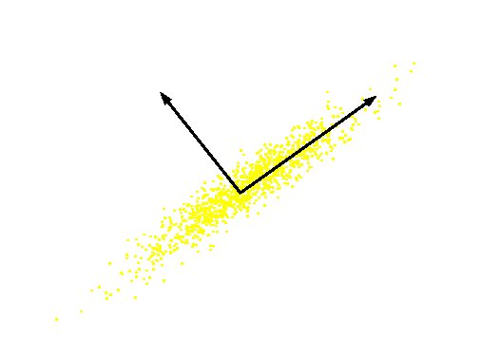
PCA
Dimension Reduction
Definition: Given a set of data , find the principal axes are those orthonormal axes onto which the variance retained under projection is maximal
PC 2
Original Variable B
PC 1
Original Variable A

Slide 12
Formulation
Dimension Reduction
Variance on the first dimension
var(U₁)=var(w^{T}X)=w^{T}Sw
S: covariance matrix of X
Objective: the variance retains the maximal
Formulation
Solving procedure
Construct Langrangian
Set the partial derivative on to zero
As w ≠ 0 then w must be an eigenvector of S with eigenvalue λ₁

Slide 13

Multidimensional Scaling (MDS)
Dimension Reduction
History: T. Cox and M. Cox, 2001
Attempts to preserve pairwise distances
Different formulation of PCA, but yields similar result form

Slide 14
MDS Example
Dimension Reduction

Slide 15
Models
Dimension Reduction
Nonlinear methods
Locally linear embedding (LLE)
Laplacian eigenmaps (LEM)
Isomap
Stochastic Neighbor Embedding (SNE)

Slide 16
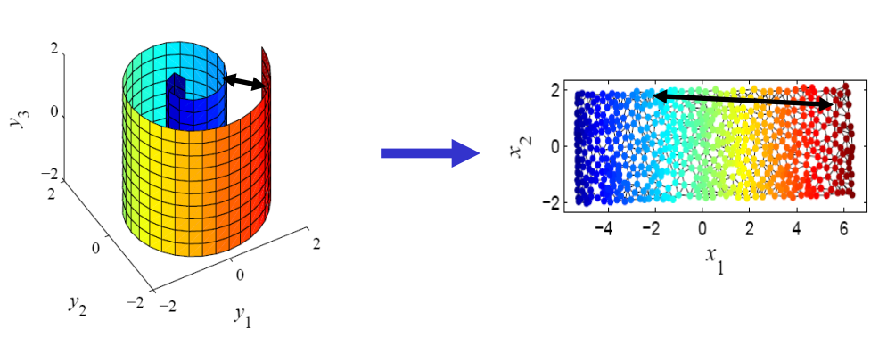
Dimension Reduction
Nonlinear projections
Goal: to unfold, rather than to project (linearly)

Slide 17
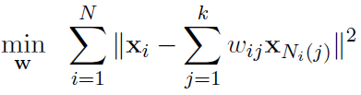

Locally Linear Embedding (LLE)
Dimension Reduction
History: S. Roweis and L. Saul, Science, 2000
Procedure
Identify the neighbors of each data point
Compute weights that best linearly reconstruct the point from its neighbors
Find the low-dimensional embedding vector which is best reconstructed by the weights determined in Step 2
Centering Y with unit variance

Slide 18
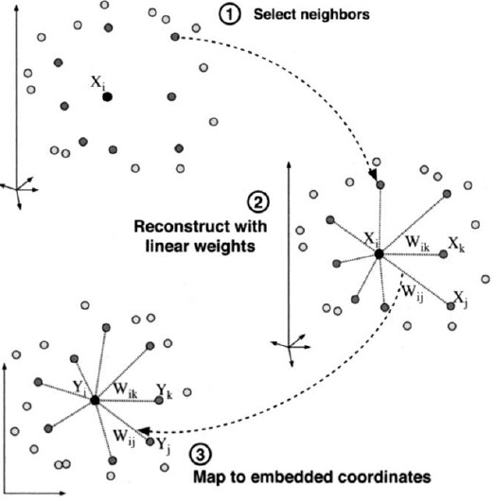
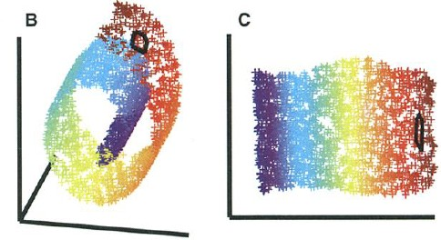
Locally Linear Embedding (LLE)
Dimension Reduction
Geometry based objective
Generalized eigenvalue decomposition Nonlinear mapping
Local method
Sam Roweis & Lawrence Saul. Nonlinear dimensionality reduction by locally linear embedding. Science, v.290 no.5500 , Dec.
22, 2000. pp.2323—2326.

Slide 19
LLE Example
Dimension Reduction

Slide 20
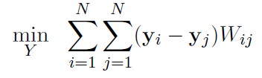

Laplacian Eigenmaps (LEM)
Dimension Reduction
History: M. Belkin and P. Niyogi, 2003
Similar to locally linear embedding
Different in weights setting and objective function
Weights
Objective
2

Slide 21
LEM Example
Dimension Reduction

Slide 22
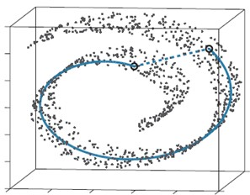
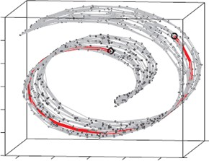
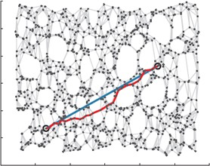
Isometric Feature Mapping (ISOMAP)
Dimension Reduction
Construct the neighborhood graph
Compute the shortest path length (geodesic distance) between pairwise data points
Recover the low-dimensional embeddings of the data by Multi-Dimensional Scaling (MDS) with preserving those geodesic distances
J. B. Tenenbaum, V. de Silva and J. C. Langford. A Global Geometric Framework for Nonlinear Dimensionality Reduction. Science 2000.

Slide 23
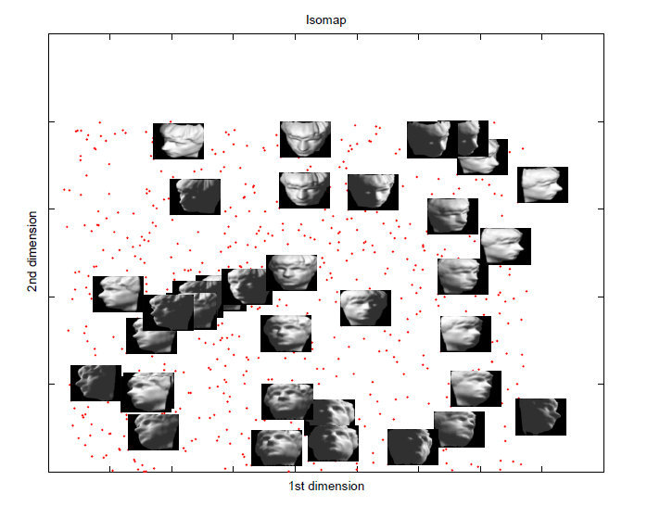
Isomap Example
Dimension Reduction

Slide 24
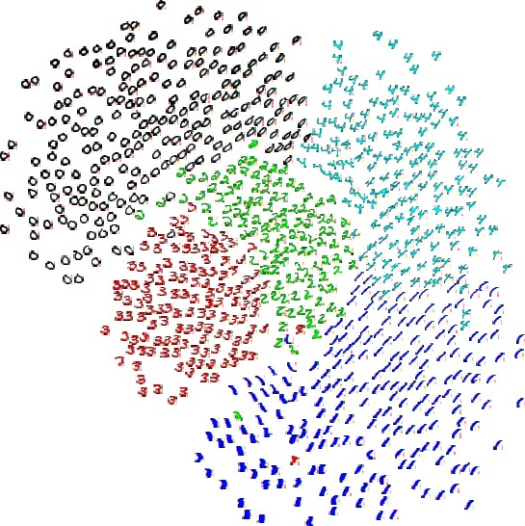



Stochastic Neighbor Embedding (SNE)
Dimension Reduction
The probability that i picks j as its neighbor
Neighborhood distribution in the embedded space
Neighborhood distribution preservation
Hinton, G. E. and Roweis, S. Stochastic Neighbor Embedding. NIPS 2003.

Slide 25
Part 2. Feature Selection

Slide 26
Motivation
Feature Selection
Especially when dealing with a large number of variables there is a need for dimensionality reduction!
Feature Selection can significantly improve a learning algorithm’s performance!

Slide 27
Feature Subset Selection
Feature Selection
Goal:
- Find the optimal feature subset.
(or at least a “good one.”)
Classification of methods:
Filters
Wrappers
Embedded Methods

Slide 28

Feature Selection
Filter Methods
Select subsets of variables as a pre-processing step, independently of the used classifier!!

Slide 29
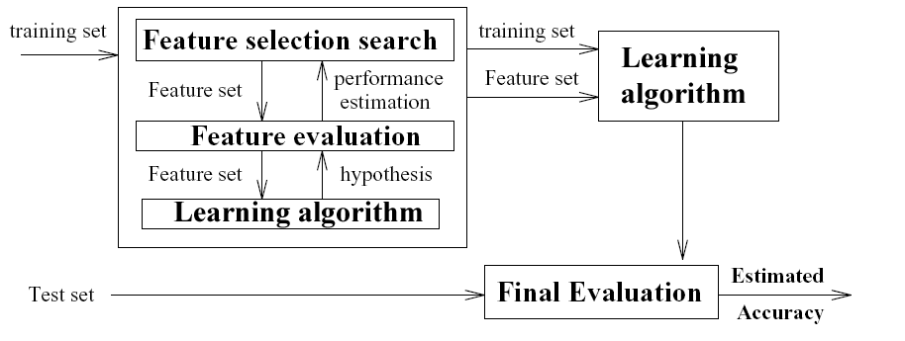
Feature Selection
Wrapper Methods

Slide 30
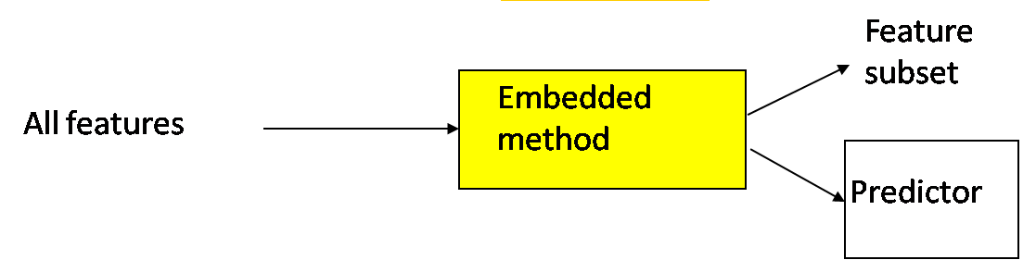
Feature Selection
Embedded Methods
Specific to a given learning machine!
Performs variable selection (implicitly) in the process of training

Slide 31
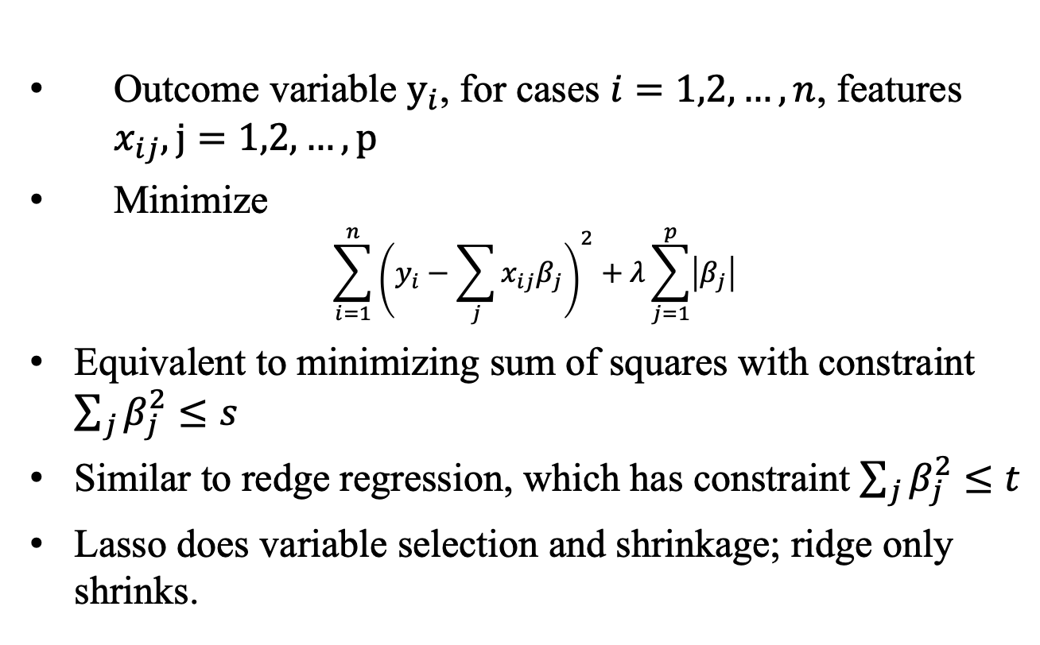
LASSO
Least Absolute Shrinkage and Selection Operator
Example
Outcome variable $y_{i}$, for cases $i=1,2,…,n$, features $x_{ij}, j=1,2,…,p$
Minimize
$$\sum_{i=1}^{n}{{\left(y_{i}−\sum_{j}{x_{ij}β_{j}}\right)}^{2}+λ\sum_{j=1}^{p}{\left|β_{j}\right|}}$$
Equivalent to minimizing sum of squares with constraint $\sum_{j}{β_{j}^{2}}≤s$
Similar to redge regression, which has constraint $\sum_{j}{β_{j}^{2}}≤t$
Lasso does variable selection and shrinkage; ridge only shrinks.

Slide 32
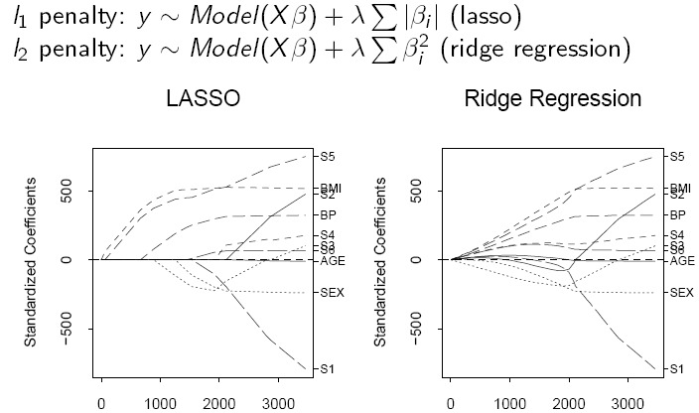
Feature Selection
Embedding methods
sum(|beta|)
sum(|beta|)

Slide 33
1 and 2 Norm Regularization
Feature Selection

Slide 34
Part 3. Subspace Clustering

Slide 35
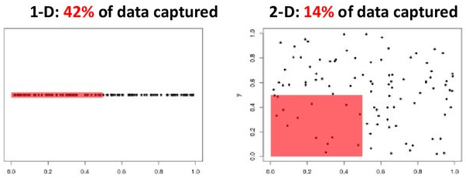
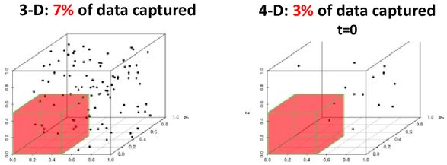
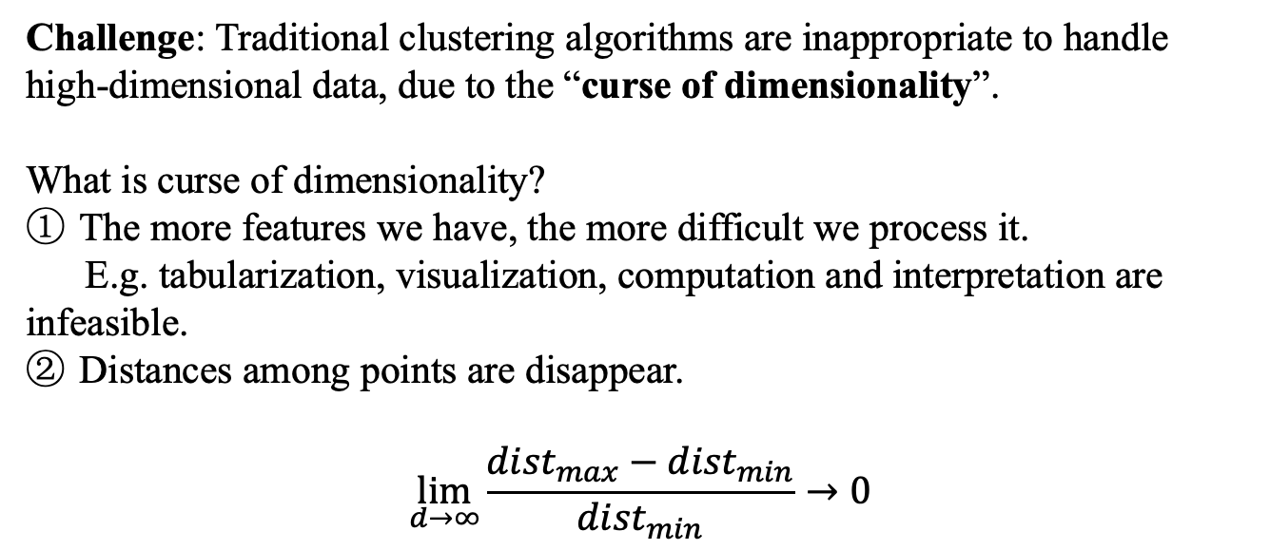
Motivation
Challenge: Traditional clustering algorithms are inappropriate to handle high-dimensional data, due to the “curse of dimensionality”.
What is curse of dimensionality?
The more features we have, the more difficult we process it.
E.g. tabularization, visualization, computation and interpretation are infeasible.
Distances among points are disappear.
$$\lim_{d→∞}{\frac{{dist}_{max}−{dist}_{min}}{{dist}_{min}}}→0$$

Slide 36
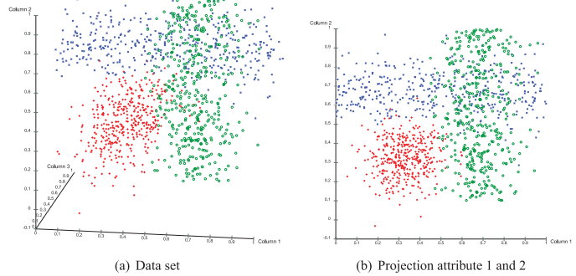
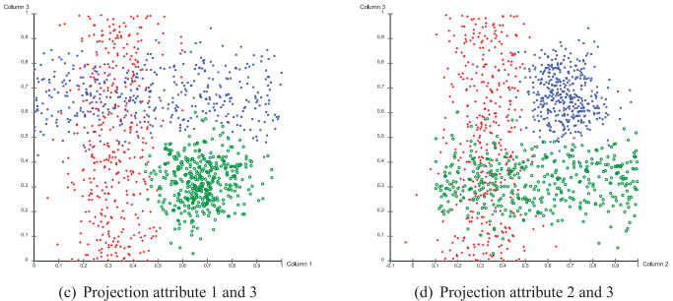
Motivation
Existing relevant and irrelevant attributes.
However, The relevance of certain attributes differ for different groups of objects within the same dataset. Thus global feature reduction methods are failed!
There are correlations among subsets of attributes.
There are redundant attributes in the data set. Somehow it can be regarded as a breakthrough point for subspace clustering.

Slide 37
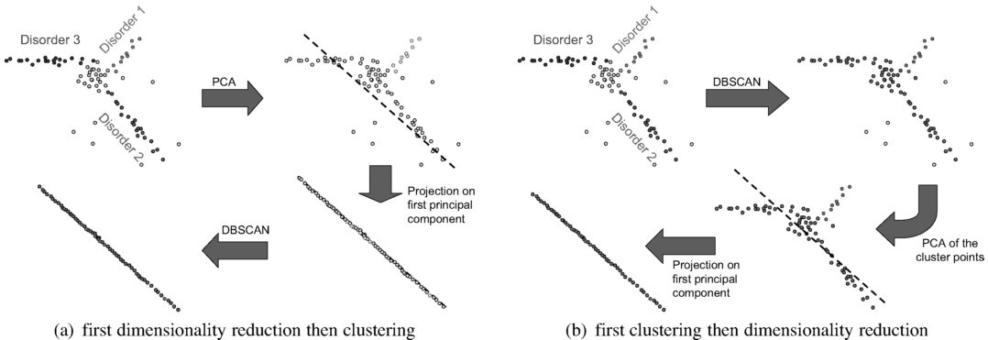
Motivation
Global feature transformation fails.

Slide 38
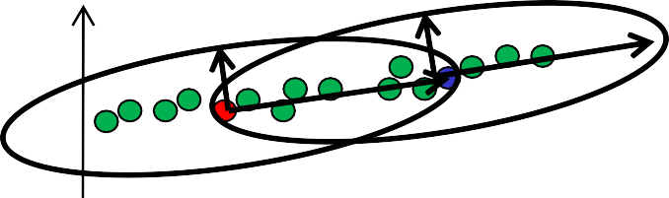
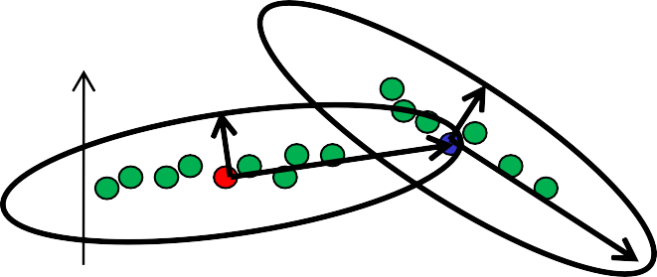
Correlation Clustering Algorithms
PCA-based algorithms:
4C [BKKZ04]
Integrates distance function into DBSCAN
Instance-based locality assumption
Enhancements:
COPAC [ABK+07c]
» more efficient and robust
ERiC [ABK+07b]
» finds hierarchies of correlation clusters
distance q
distance p
q
p
distance p
q
distance q
p

Slide 39
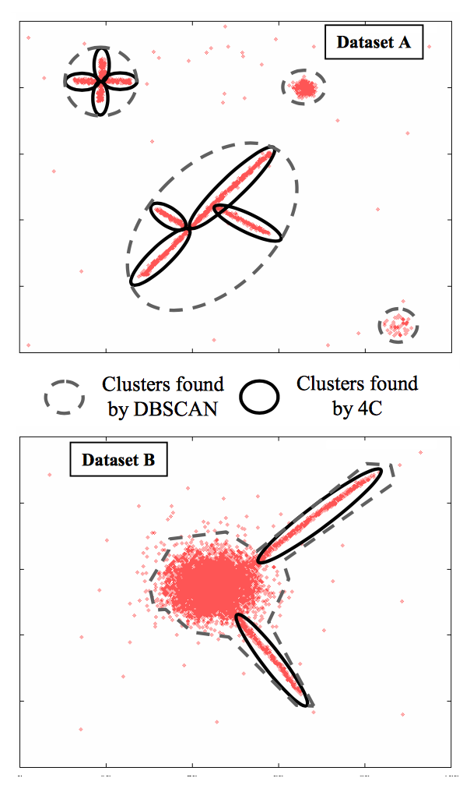
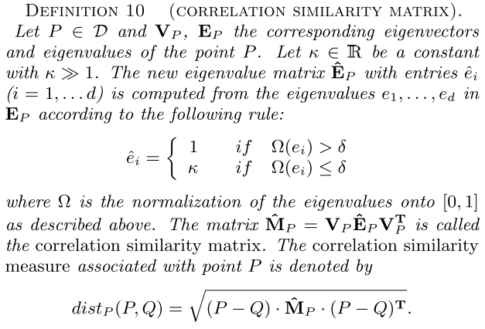
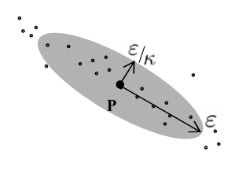
Correlation Clustering Algorithms

Slide 40
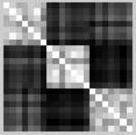
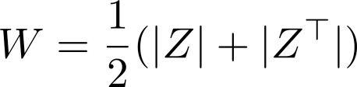
Sparse Subspace Clustering
Sparse subspace clustering (SSC)
(convex relaxation)
Affinity matrix:
Elhamifar, et al. Sparse Subspace Clustering. CVPR 2009
Cheng, et al. Learning with l1-graph for Image Analysis. TIP 2010
Elhamifar, et al. Sparse Subspace Clustering: Algorithm, Theory, and Applications. TPAMI 2013

Slide 41


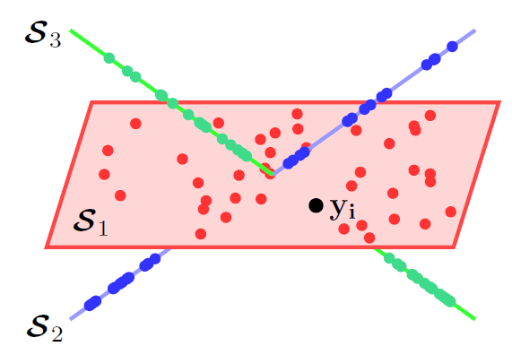
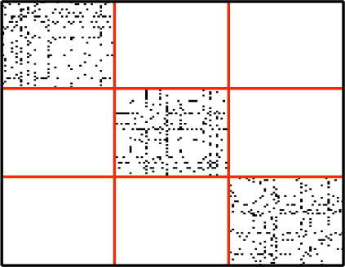
Low-rank Subspace Clustering
Low-rank representation (LRR)
(convex relaxation)
The solution Z to the LRR is block diagonal when the subspaces are independent.
LRR
Independent subspaces Block diagonal affinity matrix
Liu, et al. Robust Subspace Segmentation by Low-Rank Representation. ICML 2010
Liu, et al. Robust Recovery of Subspace Structures by Low-Rank Representation. TPAMI 2013

Slide 42
Thanks

